Slide 1
50ft
REAR
5.4ft
48.2ft
134.48ft
25.4ft
4.7ft
9.2F
109.4F
134.48ft
8.5 ft
20F
8.5 ft
Closet wall add
12 ft
20F
Property Line
Property Line
Thickness inch
7.7 ft
Putting same patio structure which was there in 2019 before remodeling started in this house. No new structure. Old structure get rotten wood
Front : 50.13ft
Side: 134.48ft
Rear : 50ft
29.8ft
50.13ft
Sidewalk
Public Street
Mulberry St
FRONT

Slide 2
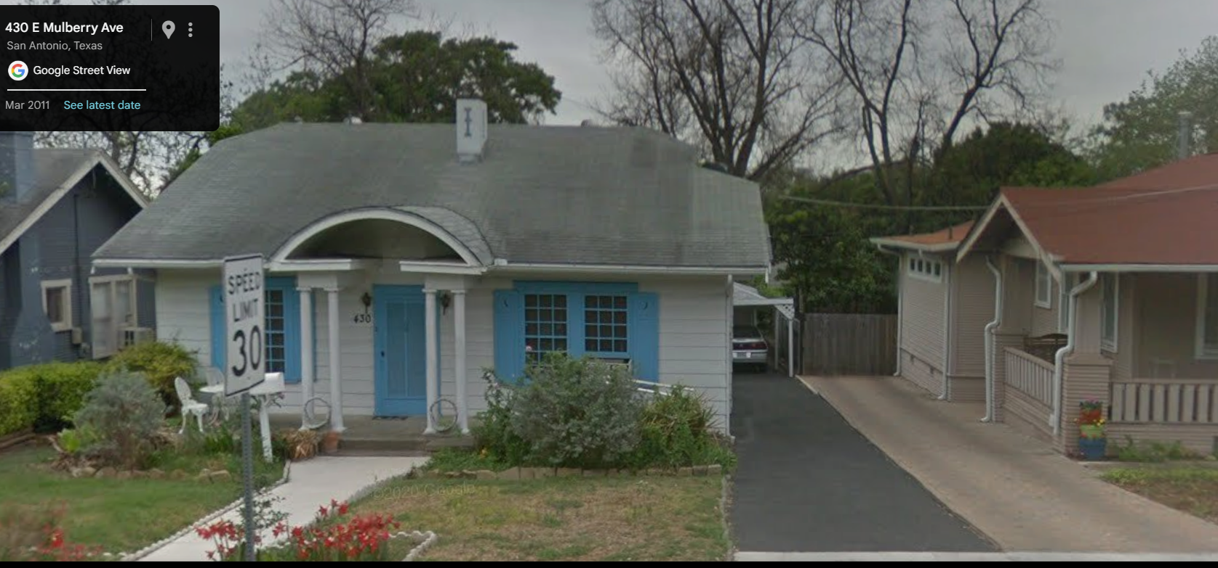
Old Structure in 2019

Slide 3
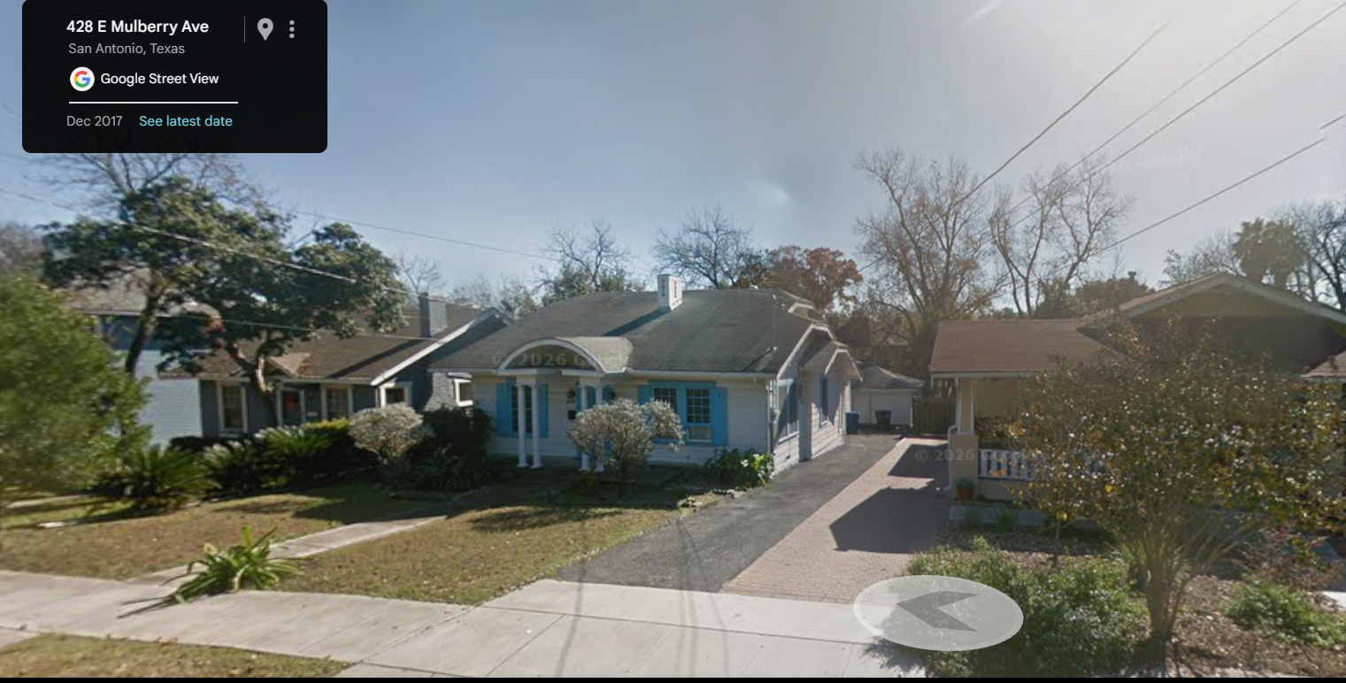
Old Structure in 2019

Slide 4
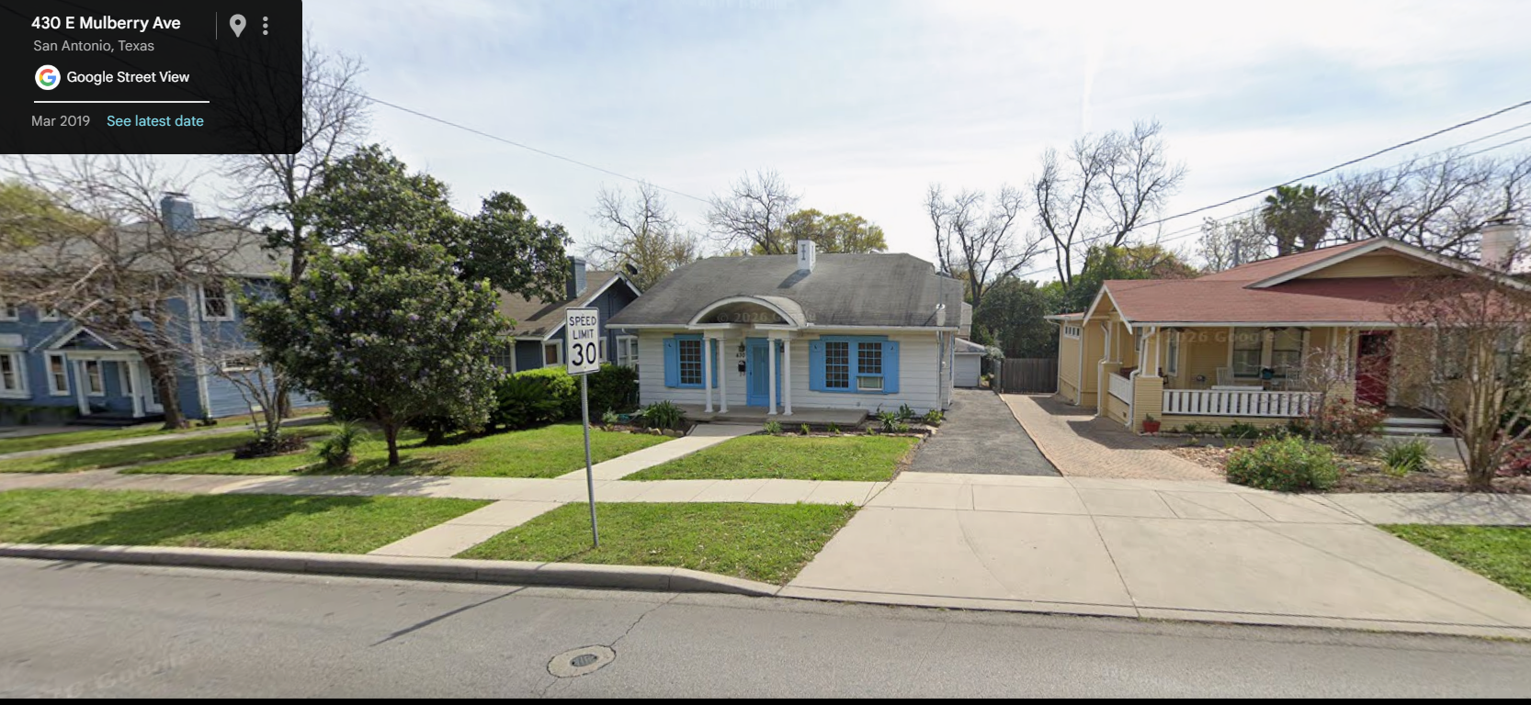
Old Structure in 2019

Slide 5
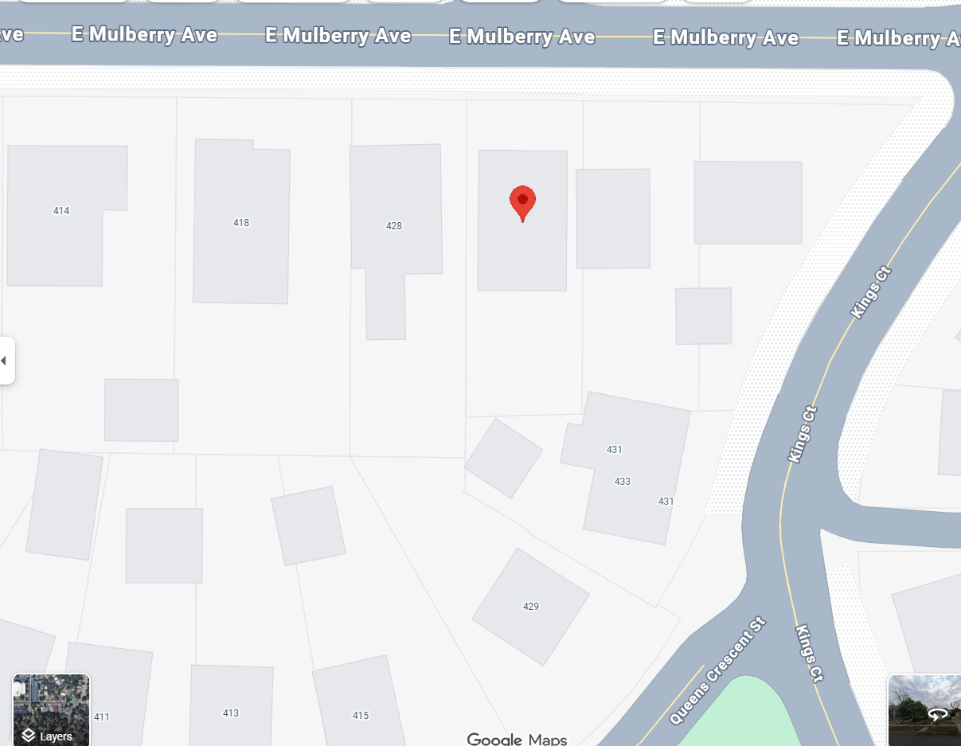
Same Structure in 2019, new planned
Neighbor similar structure

Slide 6
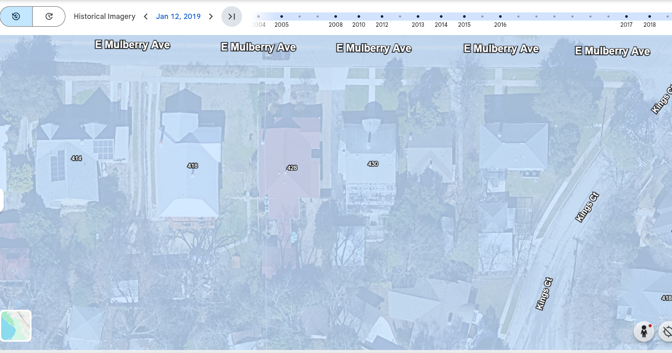
Old Structure in 2019
Neighbor similar structure

Slide 7
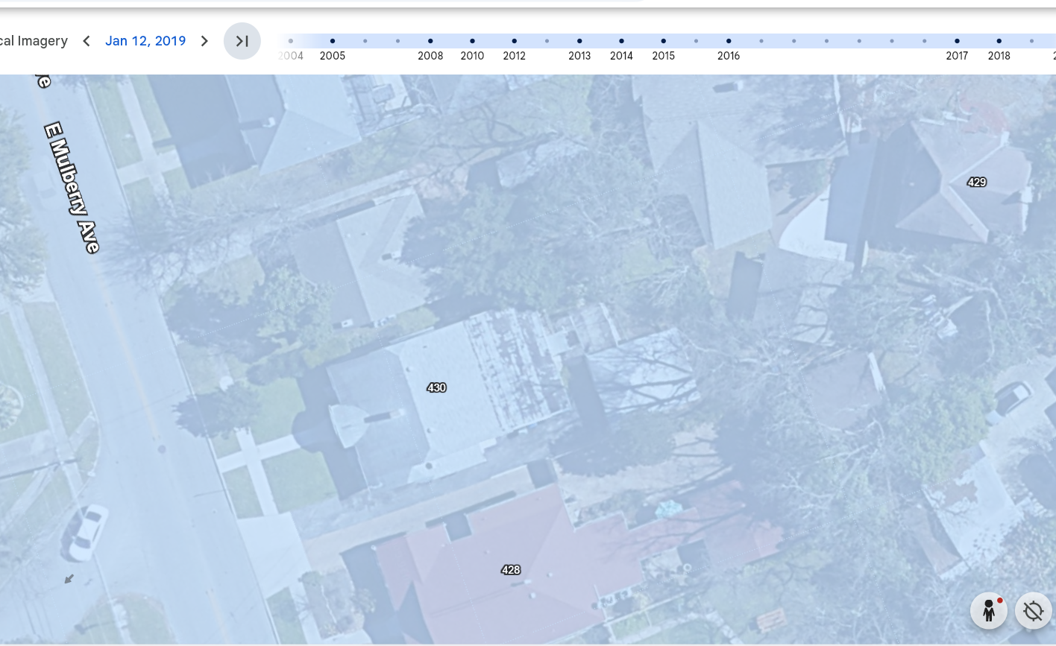
Old Structure in 2019
Neighbor similar structure

Slide 8
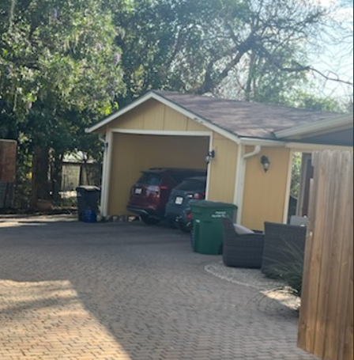
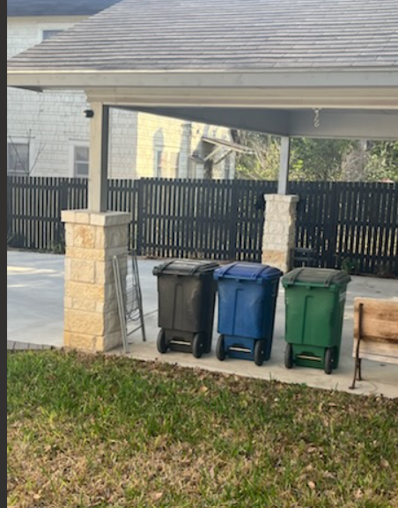
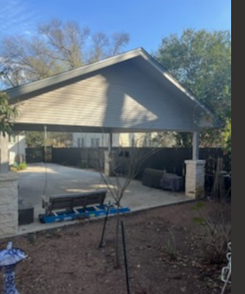
All neighbor has similar patio structure in their yard.

