Slide 1
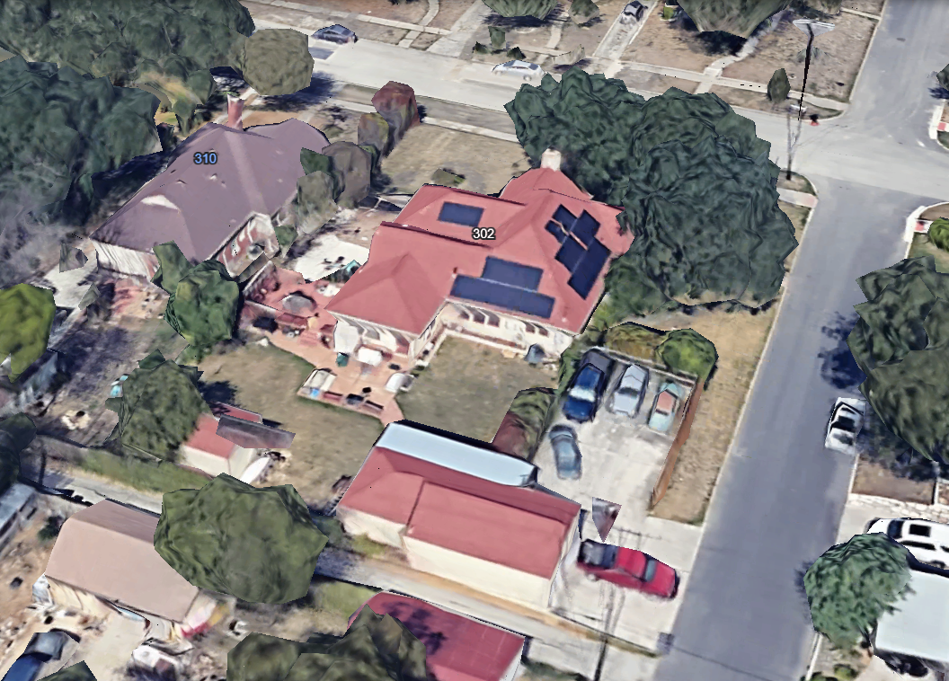
NORTH DRIVE
SHEARRER
ALLEY
302 NORTH DRIVE

Slide 2
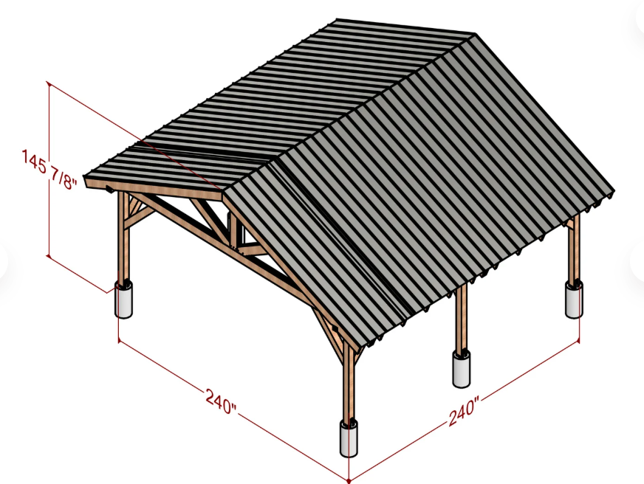
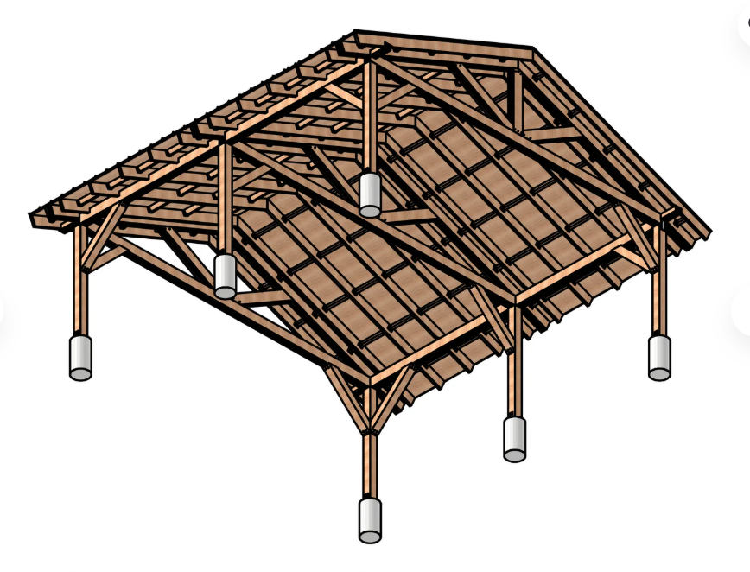

Slide 3
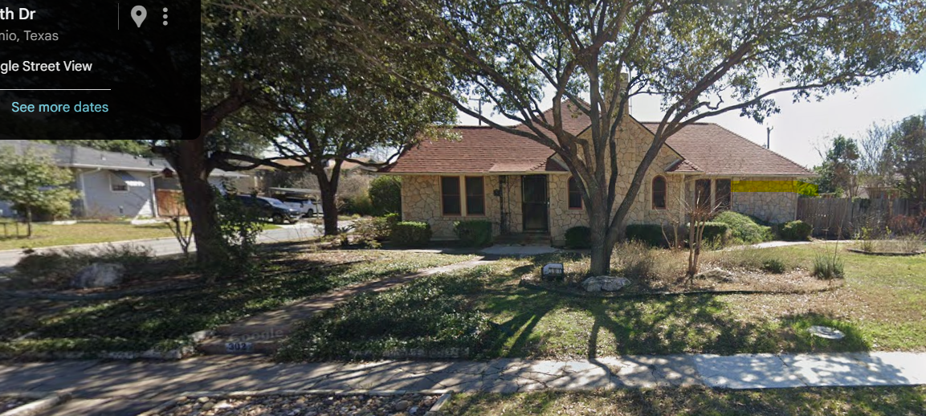

Slide 4

302 NORTH DRIVE
STEPPING STONES
SHEARRER
ALLEY
STEPPING STONES REQUEST ARIAL VIEW

Slide 5
302 NORTH DRIVE
PERGOLA
SHEARRER
ALLEY
PERGOLA REQUEST ARIAL VIEW

Slide 6
302 NORTH DRIVE
CARPORT
SHEARRER
ALLEY
CARPORT REQUEST ARIAL VIEW

Slide 7
HANDRAILS - FRONT STEPS /SIDEWALK
302 NORTH DRIVE
HANDRAILS - ENTRY INTO HOUSE
SHEARRER
ALLEY
HANDRAILS REQUEST AERIAL VIEW

