Slide 1
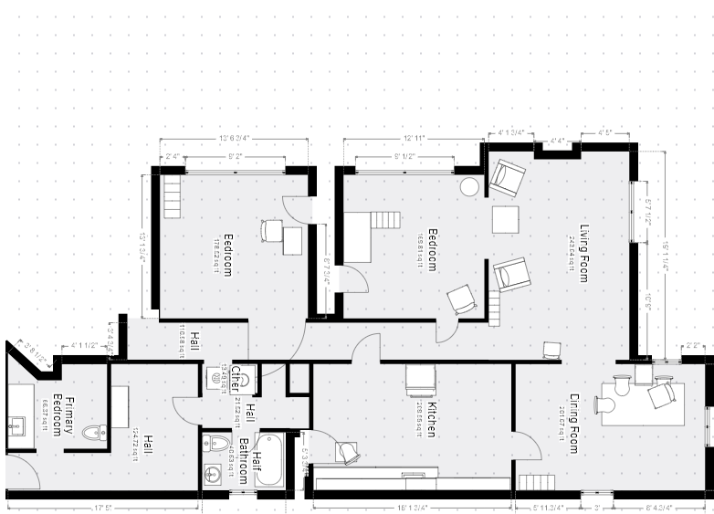
Floor Plan: Window Layout
Bedroom 2:
One 109x59 window replacement
Master Bedroom: Reopening closed window
One 109x59 window replacement
Bedroom 1:
One 109x59 window replacement
Living Room (A/B):
Two 23x36 window replacement
Front window (A):
One 70x51 window replacement
Dining Room Front window (A):
One 34x51 window replacement
Dining Room Front window (B):
One 42x51 window replacement
Kitchen Window:
One 35x34 window replacement
Shared Bathroom Window:
One 30x30 window replacement
Dining Room Side window (C/D):
Two 34x51 window replacement

Slide 2
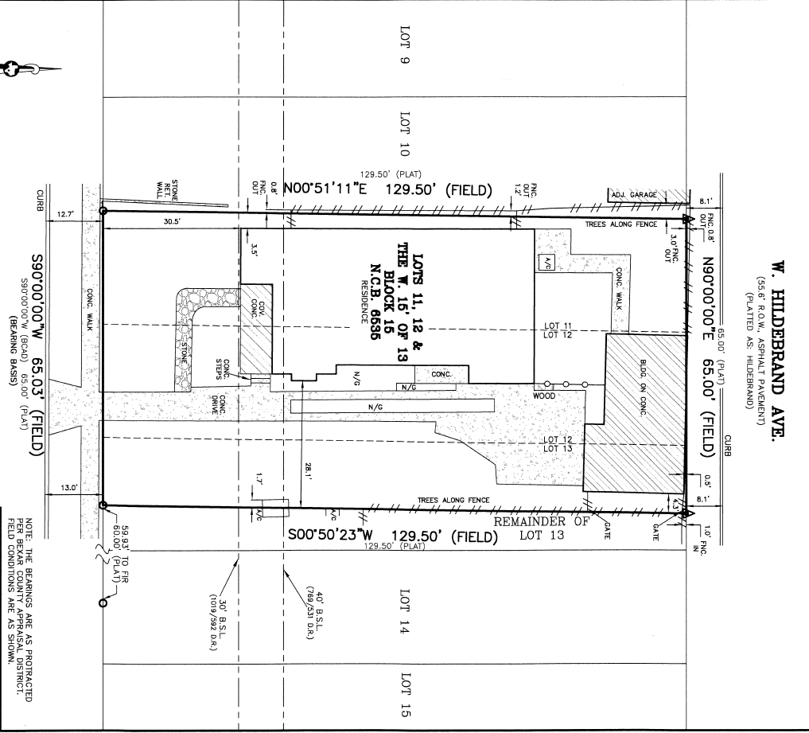
Site Plan

