Slide 1
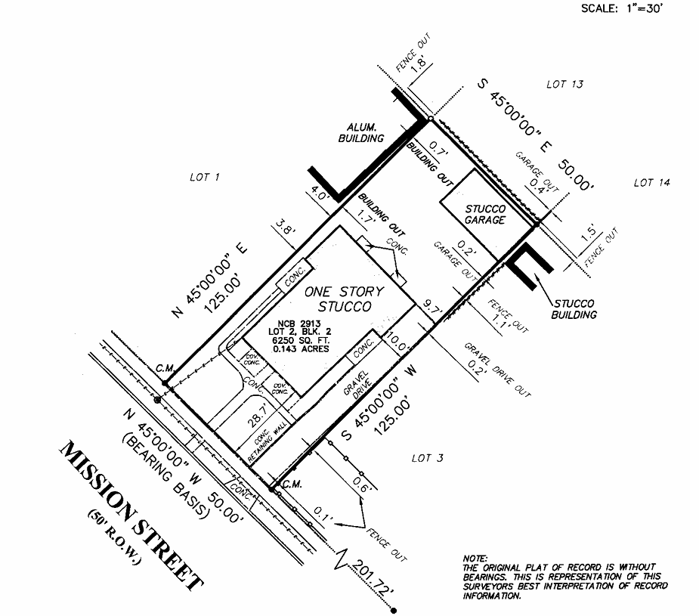
New 6 ft. tall wood fence indicated with red lines. Short fence
dividing the duplex in backyard for privacy.
Fence in backyard only (not side or front yard).
Stucco Garage needing demolished
due to very poor condition and
unsightly appearance.
Landscape: Crushed granite, small (<2 in rock
and low water plants with outdoor lighting
pointing toward house. Black mulch next to house
Removal of existing front and side yard fencing.

