Slide 1
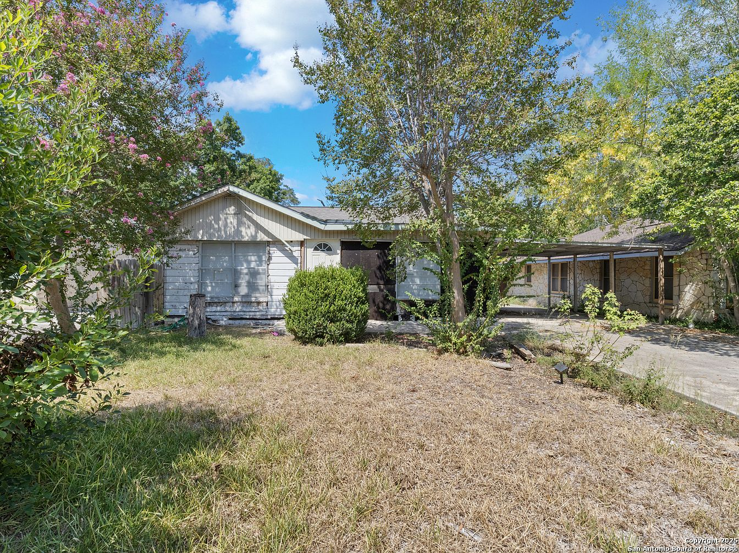
Olmos Park Terrace
219 Thorain
San Antonio TX
78212

Slide 2
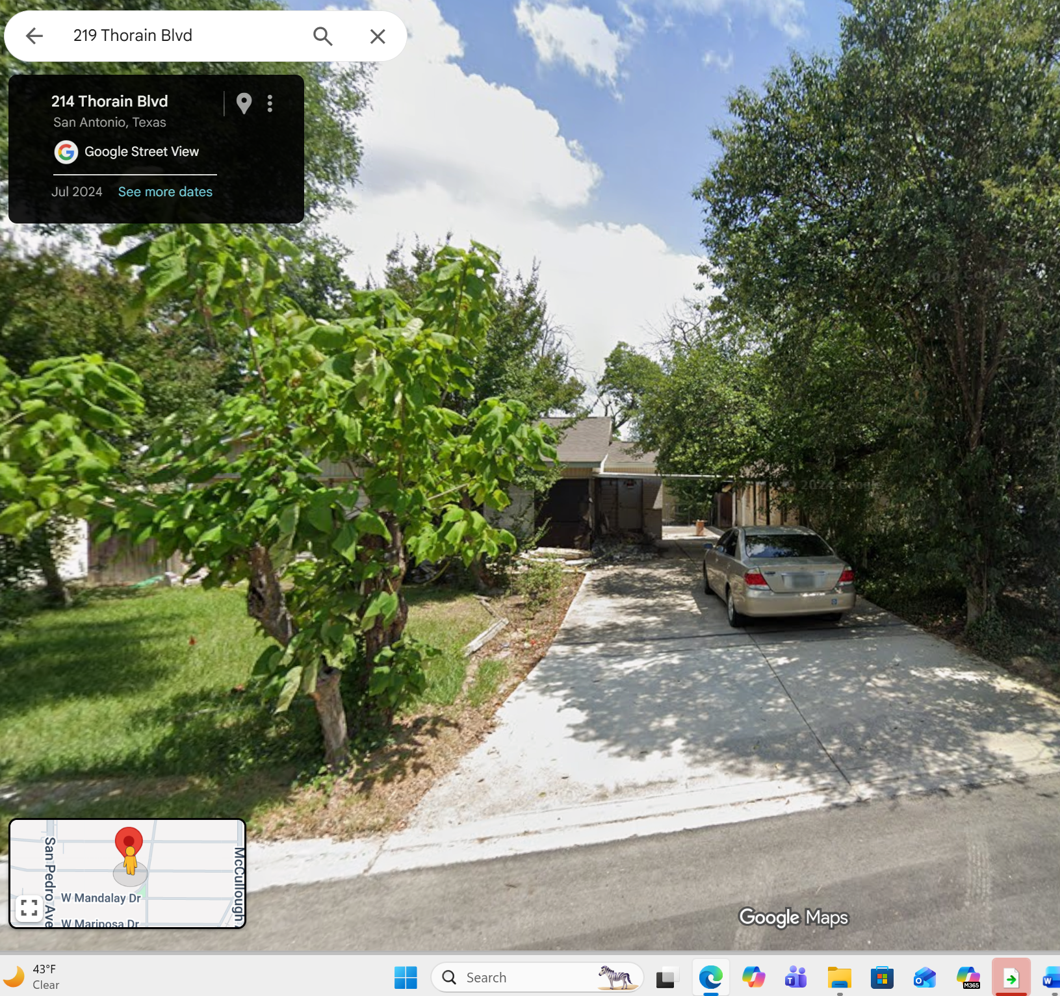
Google Area view of site location – Front view

Slide 3
Main Home Renovation Request

Slide 4
Materials Used on Home – Exterior
Home Exterior changes:
Replace 2 exterior doors; front and back.
Replace all existing aluminum 1 over 1 single glass pane windows size 36x60, to black aluminum 1 over 1 double pane (energy efficient) window size 36x60.
Replace/Restore Red Clay Cored brick on all sides of the home.
Add limewash/limewashing on exterior of home (all sides).
Add two gas lanterns on each side of the front/main door in the color black or copper.
Adding front Porch with metal roof in the color (Copper/Penny), with cedar post.
Adding detached Gable carport with cedar post, roof material will match homes existing shingles.
  * Note: Examples of materials reference are listed in each corresponding slide based on the # description.

Slide 5
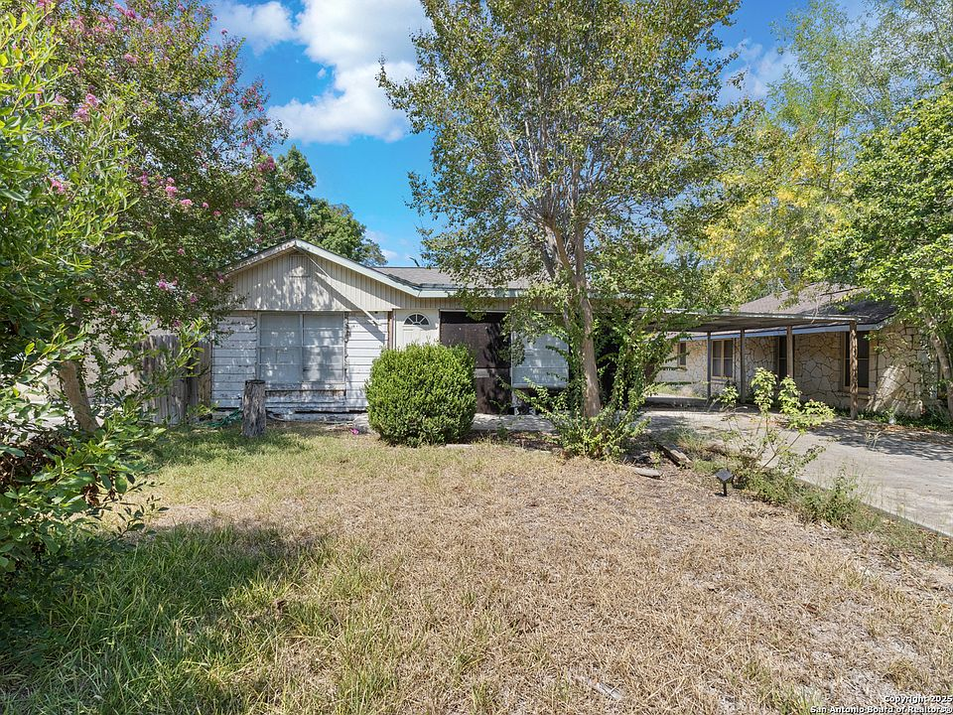
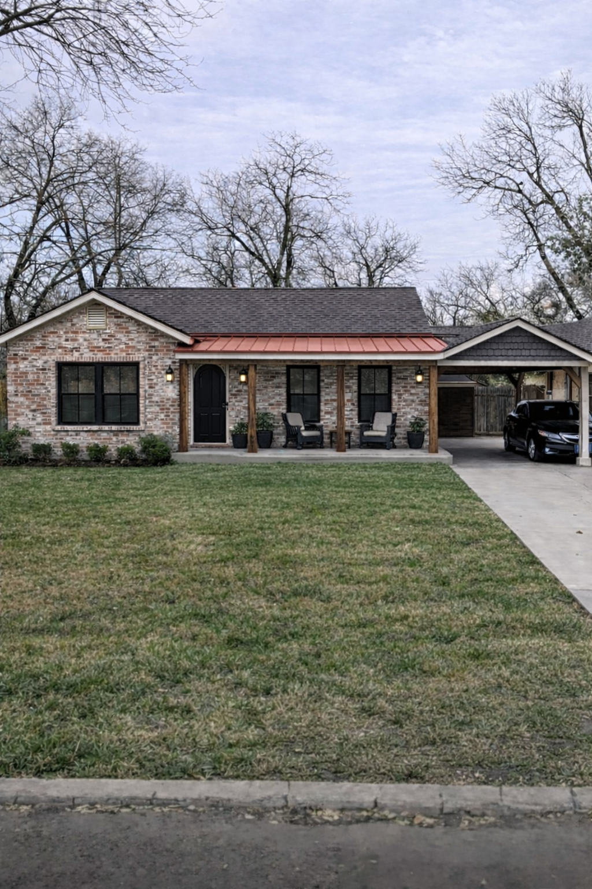
Remodel Request – Exterior Changes
As-IS
to-be
  * Note: This image is a rendering please keep in mind that colors may vary based on lighting. Car port will be detached

Slide 6
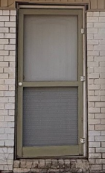
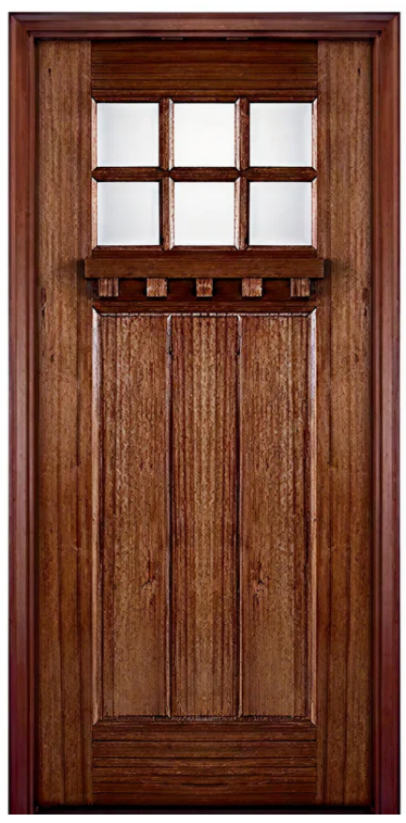
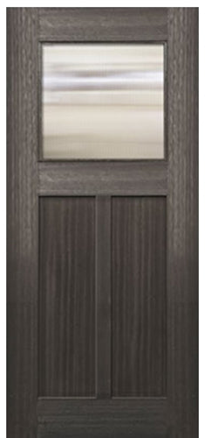
1. Exterior Doors
Front House Door
Back House Door
Exterior Front Door:
Natural Wood Color
Exterior Back Door:
Using existing door
OR

Slide 7
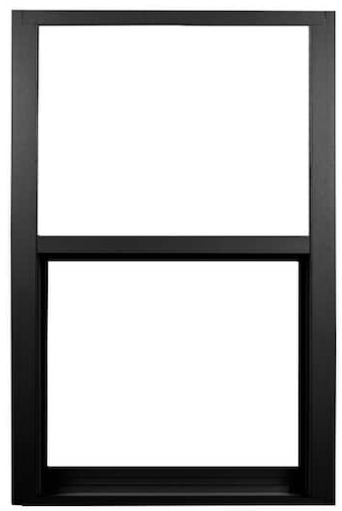
2. Windows
Windows
Windows:
Replacing existing aluminum 1 over 1 single glass pane windows size 36x60, to black aluminum 1over 1 double pane energy efficient) window size 36x60.

Slide 8
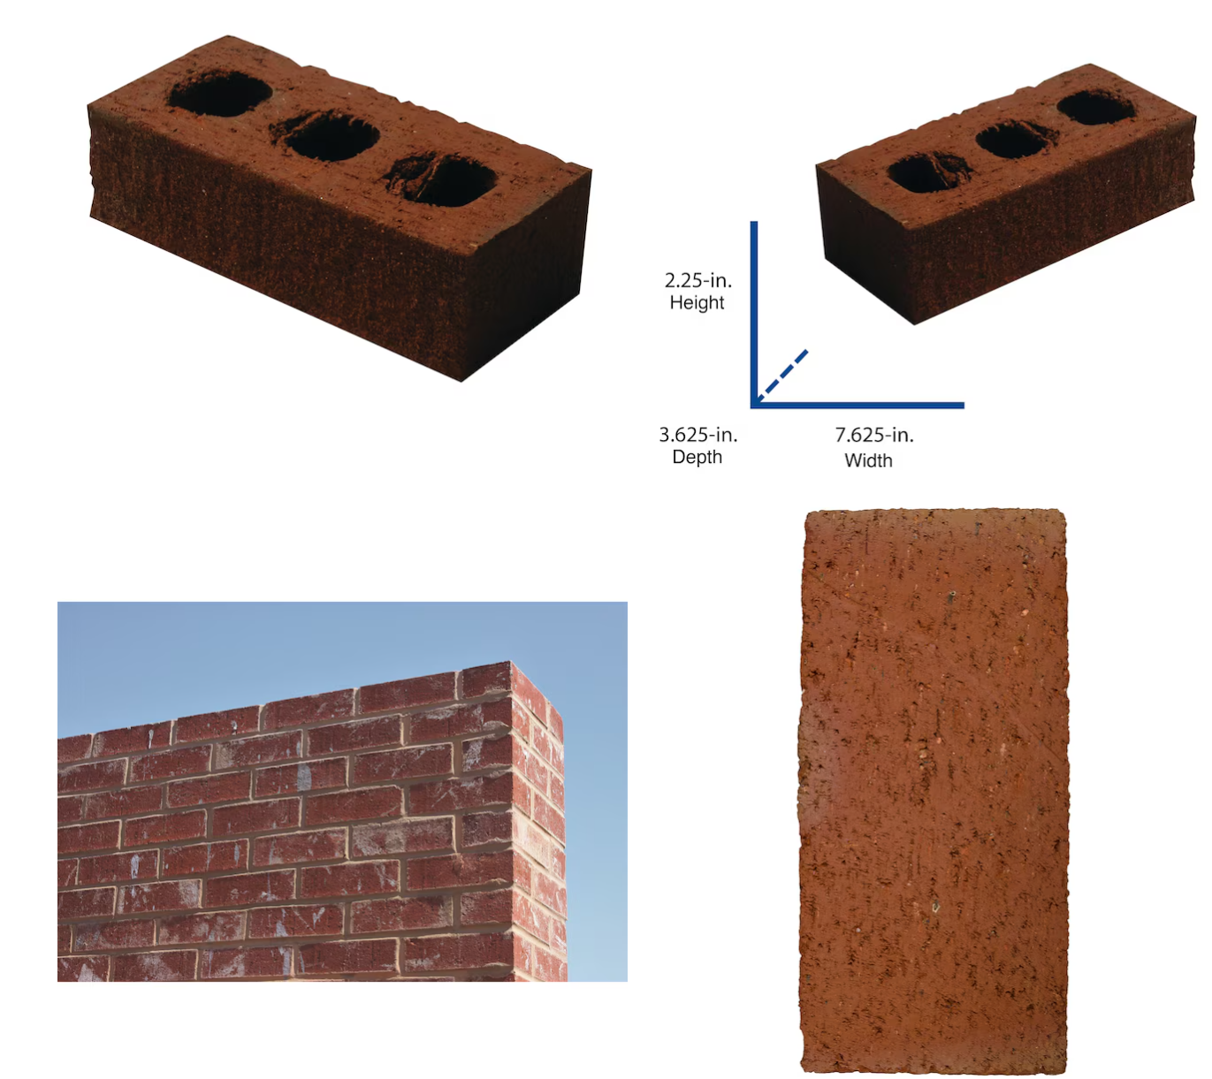
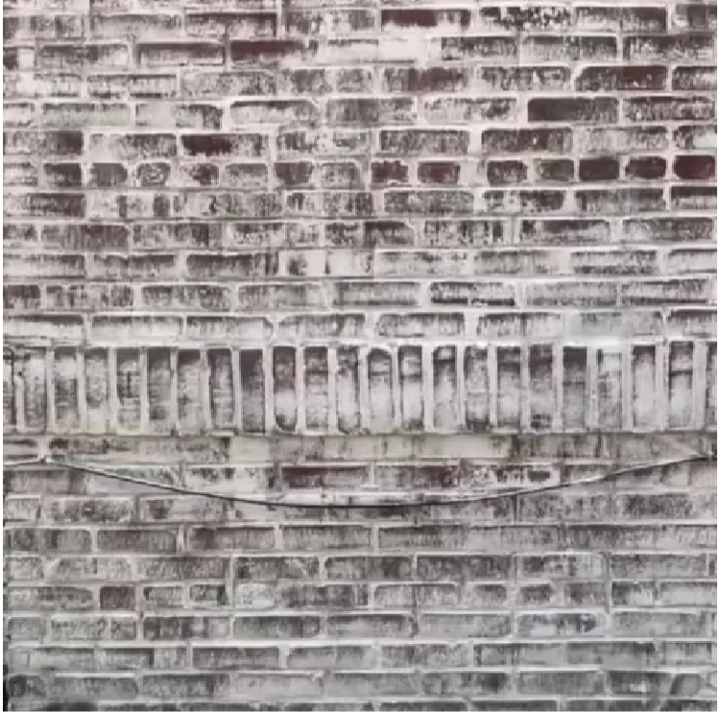
3 & 4. Brick & Limewashing-Exterior of home
Red Clay Cored Brick
All 4 sides of the exterior of the home will be restored to original red clay cored brick.
Brick will be limewashed.

Slide 9
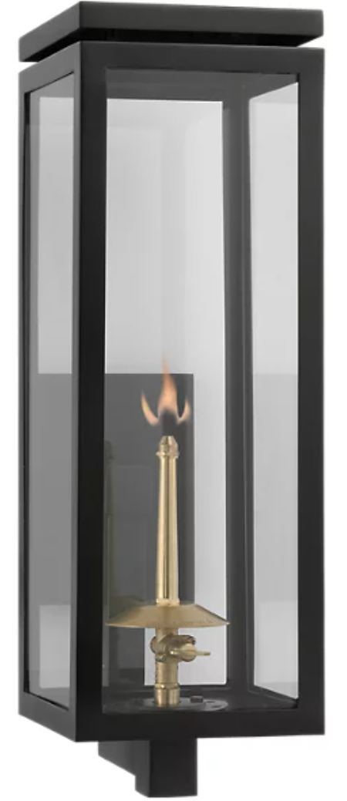
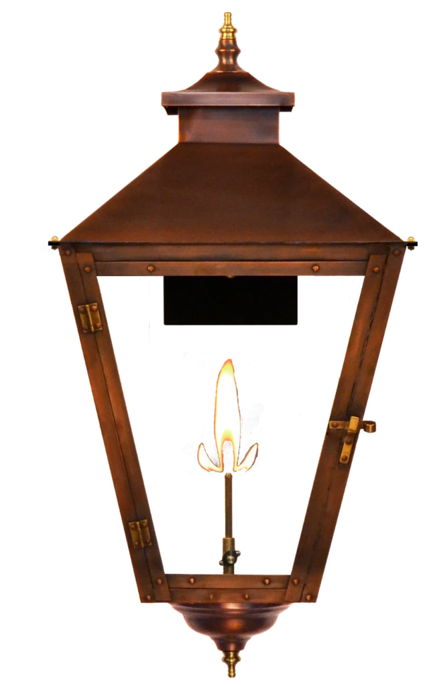
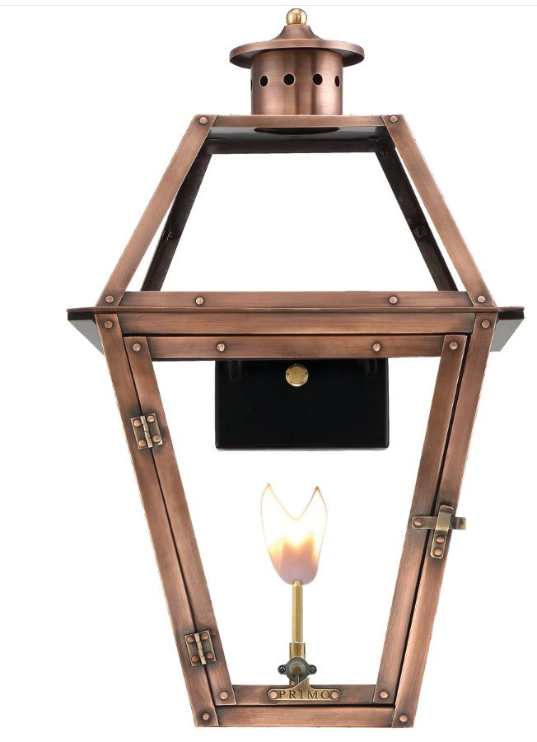
5. Front porch Gas Lanterns/ Lighting
Lanterns
Lanters used will either be black or cooper in either style presented.
OR
OR

Slide 10

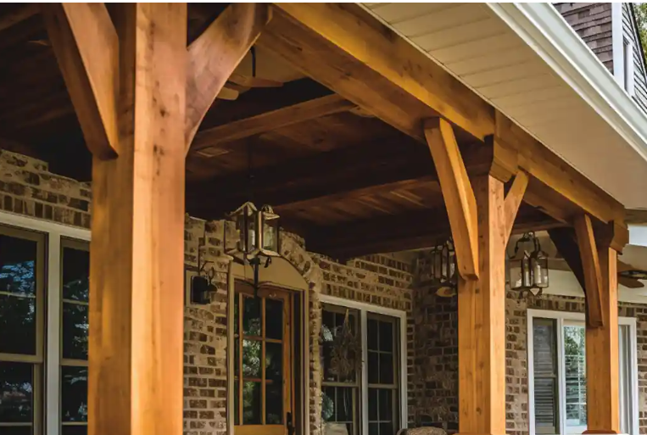
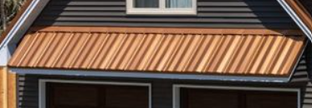
6. Porch Metal Roof and Post
Porch Roof
Porch post
Roof
Metal roof used on front porch will be in the color Penny/copper.
Post
Porch post will be stained cedar.
  * Note: Color may vary based on lighting.

Slide 11
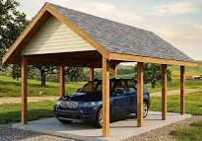
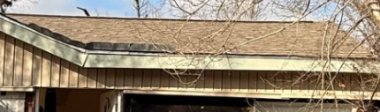
7. Gable Carport
Carport
Shingles
Carport
Carport will be detached from home and will use cedar post that will match the color of the cedar post used on the front porch.
Shingles
Shingles used on the carport will be the same as those currently on the home.

Slide 12
Home front, back and side views

Slide 13
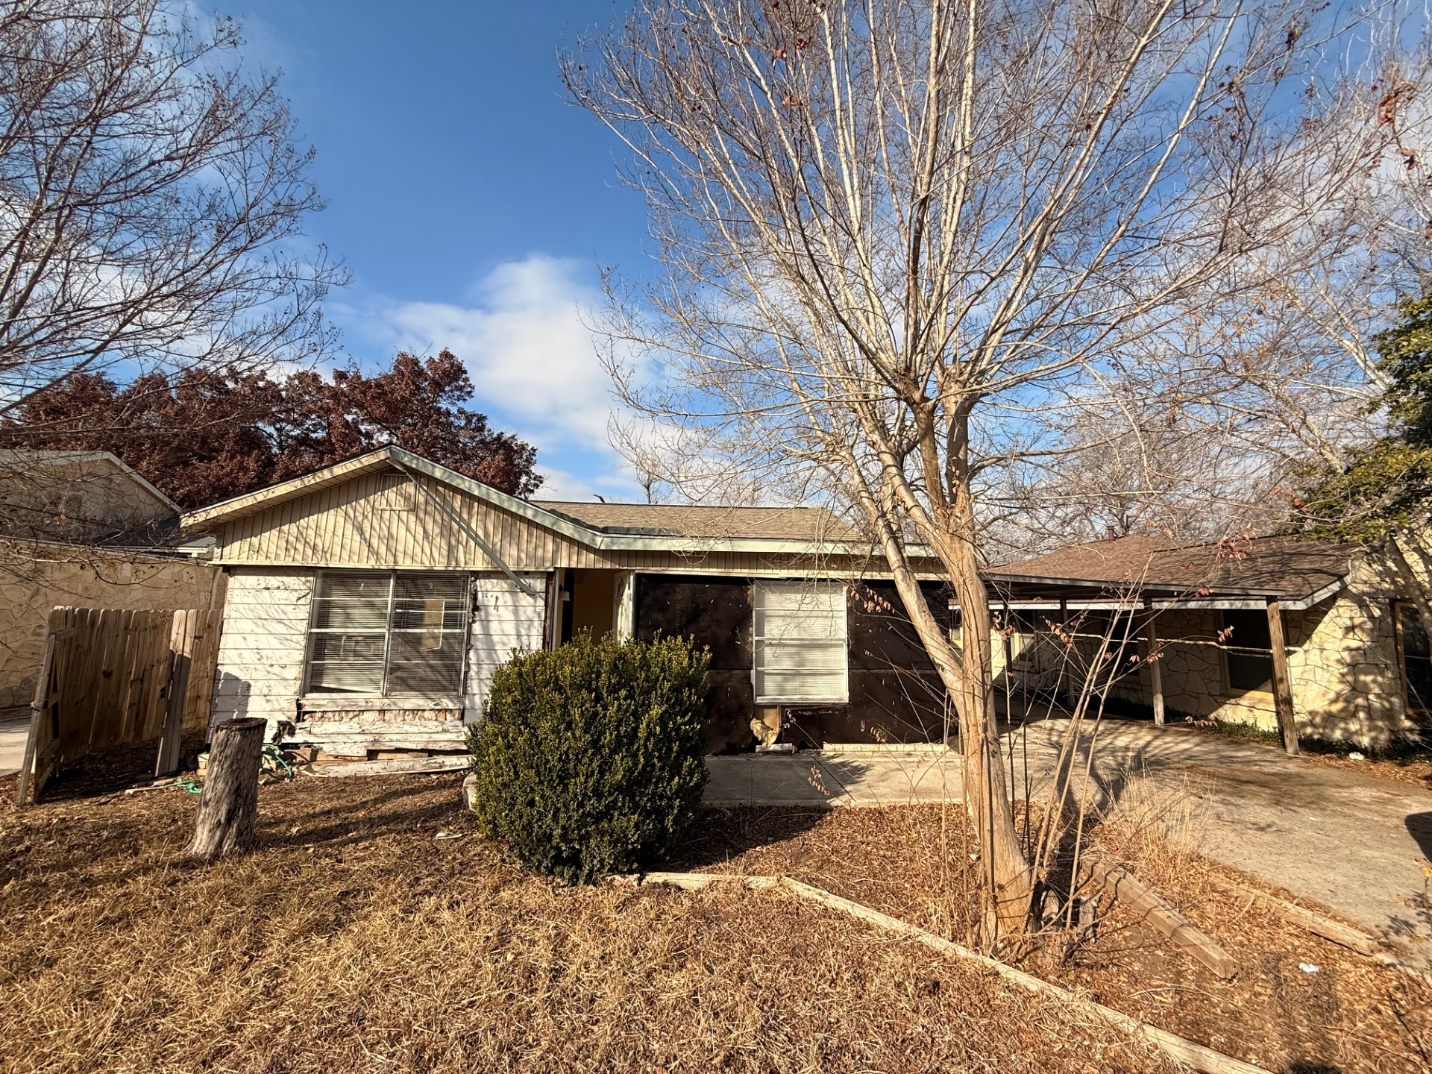
Home – Front view
As-IS
to-be
Windows
Exterior
Porch Roof
Carport
Front House Door
Porch & Carport post
OR
OR
OR
Lighting

Slide 14
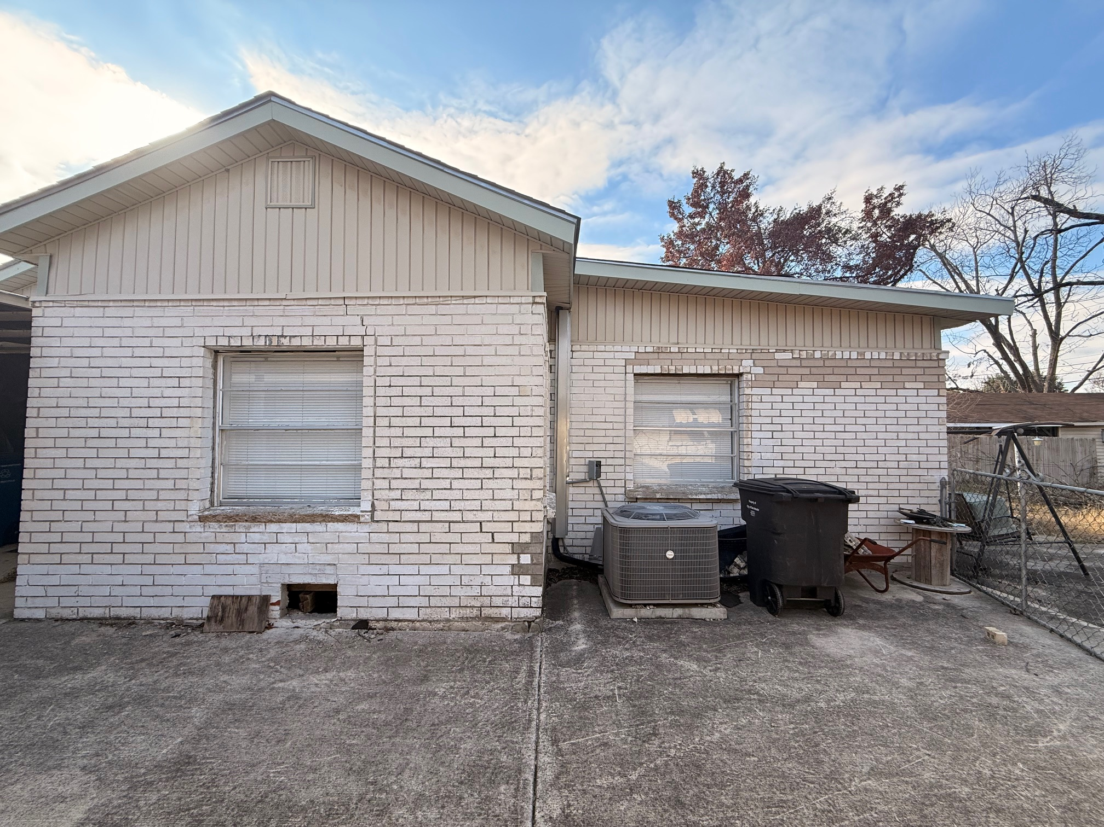
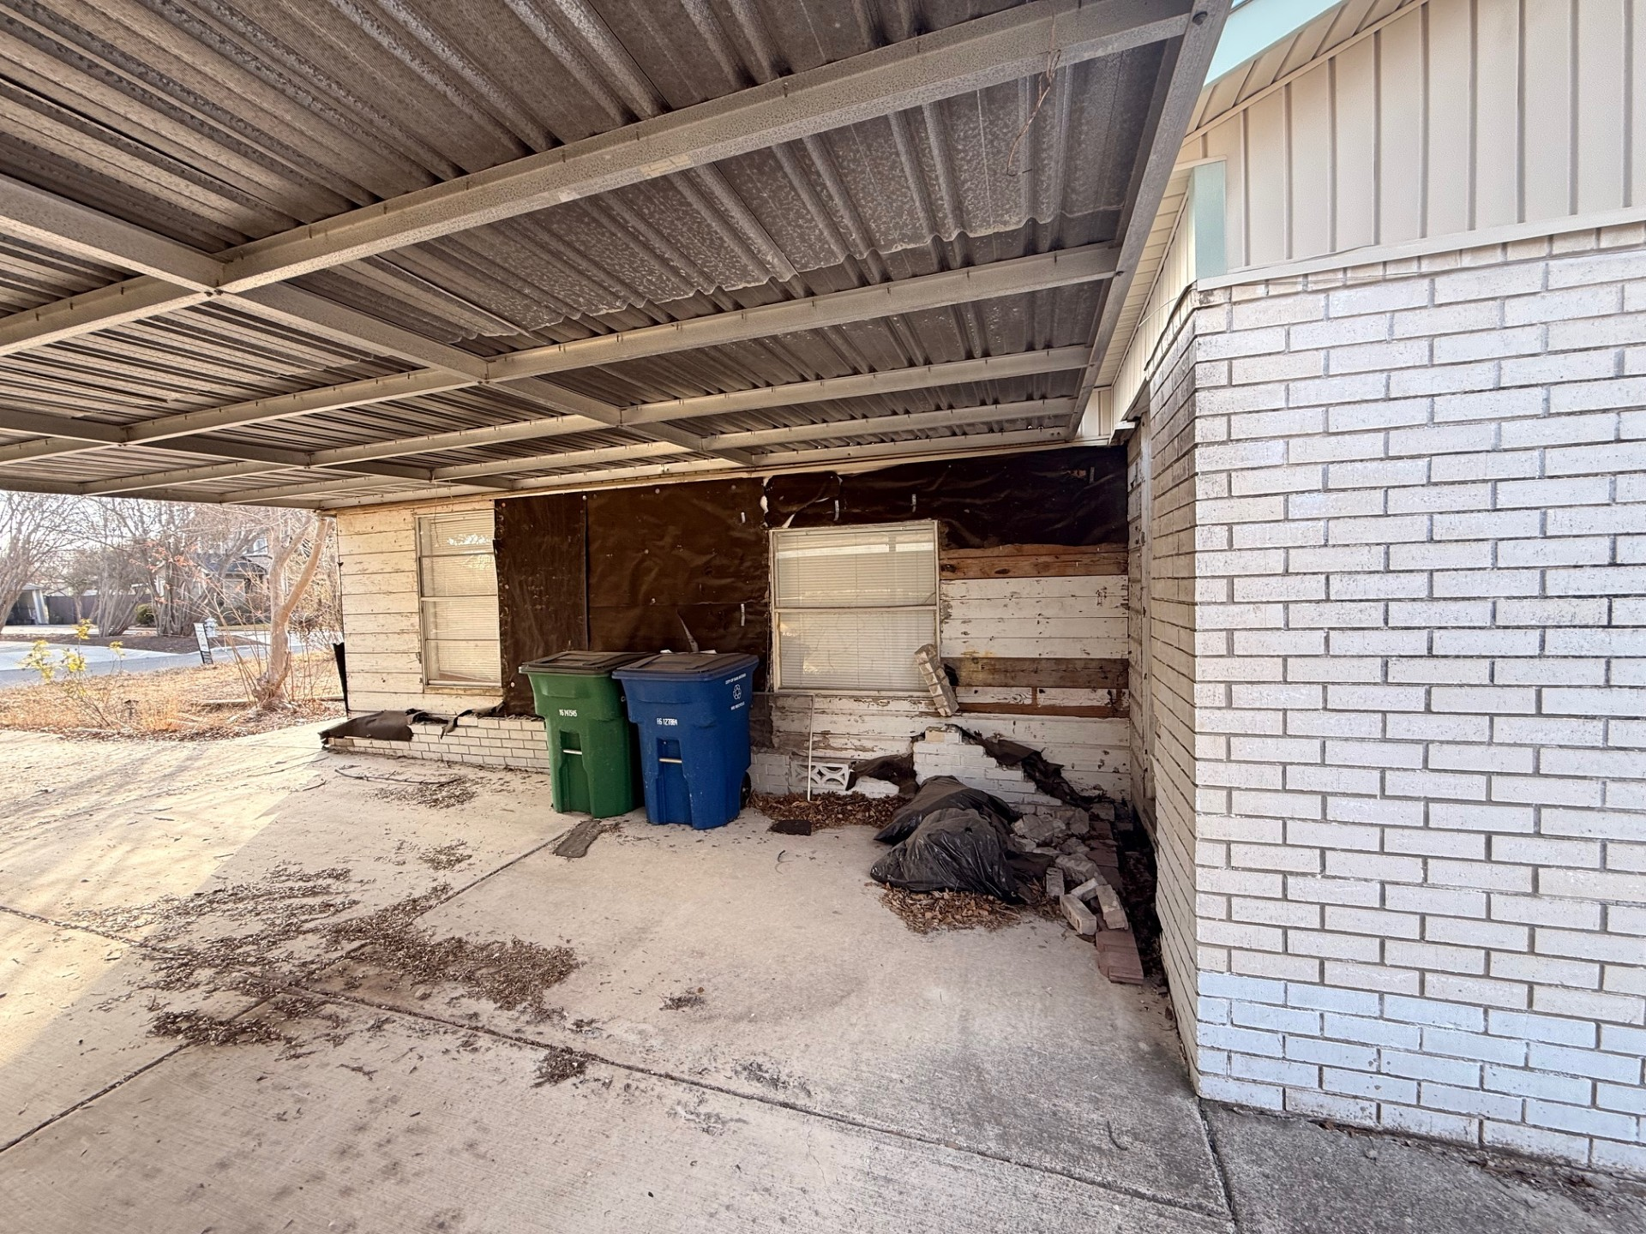
Home – Right Side view
As-IS
to-be
Exterior
Carport
Windows
Carport post
  * Note: Combined 2 images on the “As-Is” due to angle placement/limitation to take photograph.

Slide 15
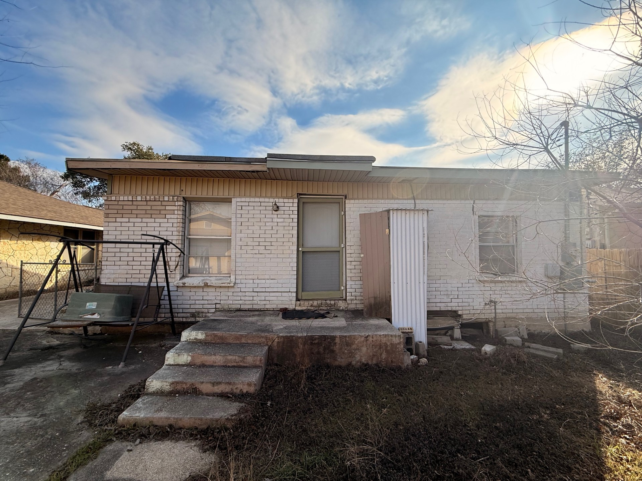
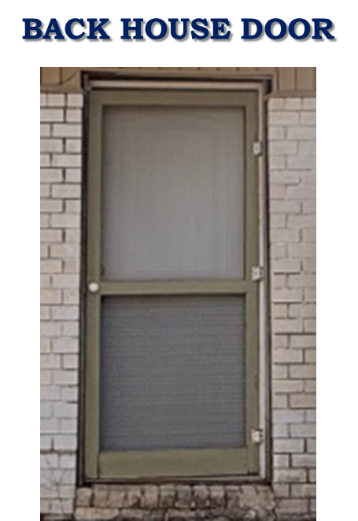
Home – back Side view
As-IS
to-be
Exterior
Windows
  * Note: No changes will be made to back door, using existing door.

Slide 16
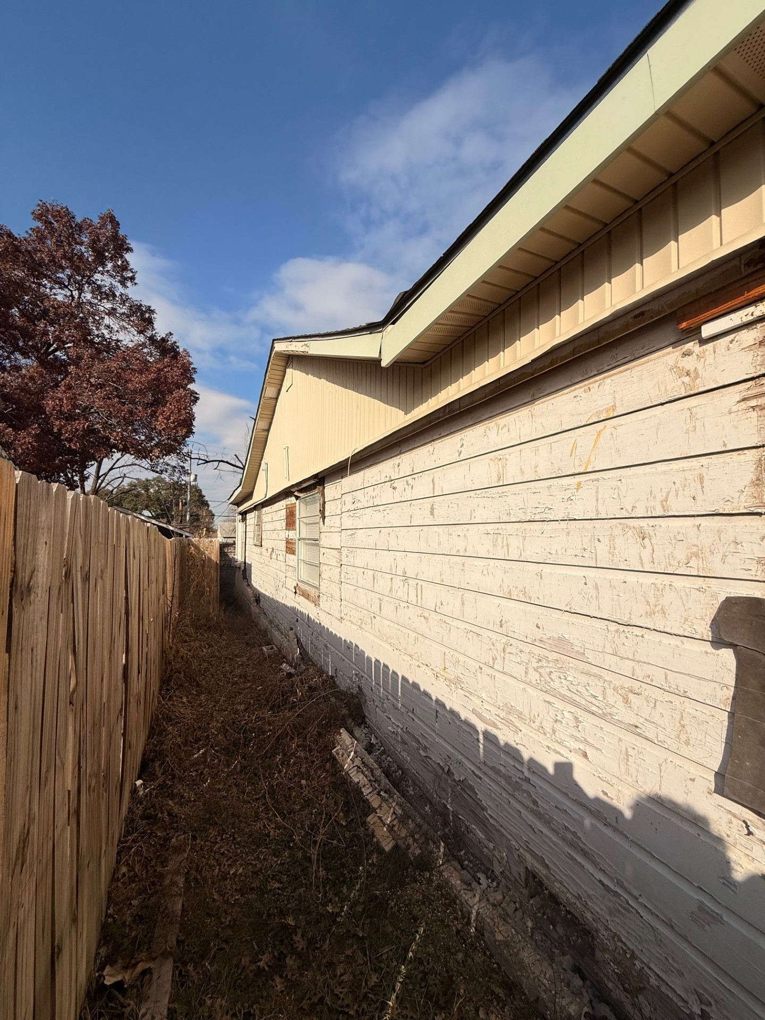
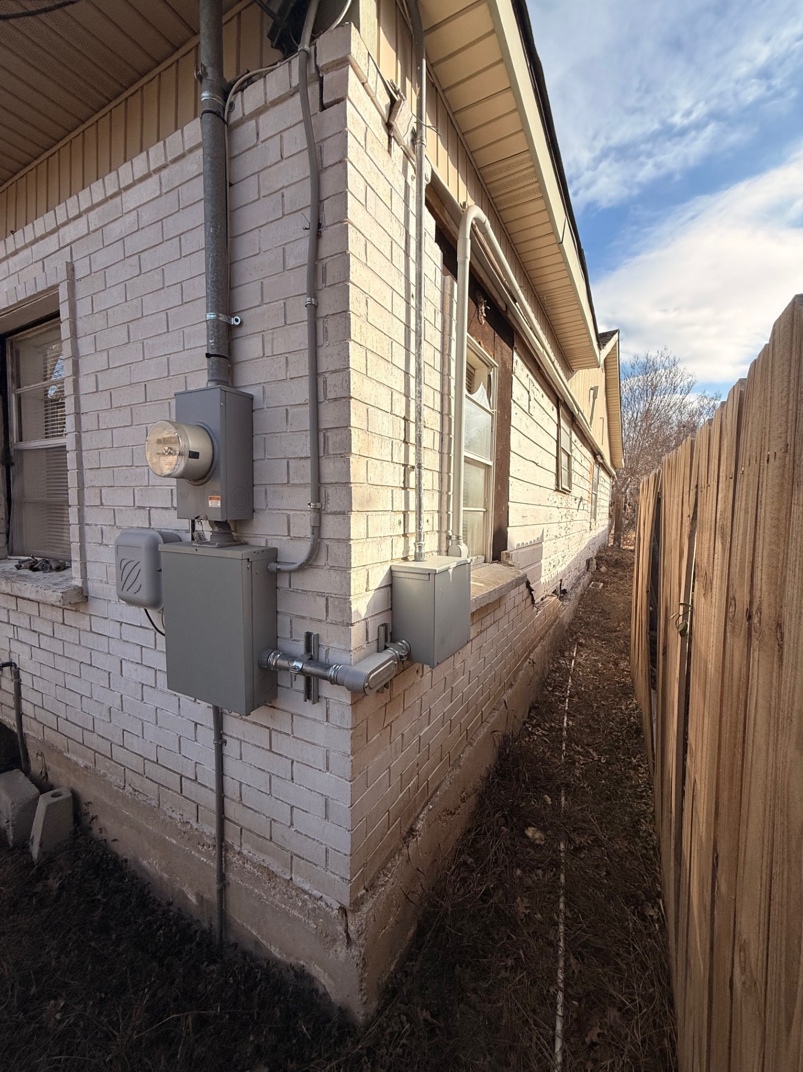
Home – Left Side view
As-IS
to-be
Exterior
Windows
  * Note: Combined 2 images on the “As-Is” due to angle placement/limitation to take photograph.

Slide 17
ADU Renovation Request

Slide 18
Materials Used on ADU – Exterior
Home Exterior changes:
Replace 2 exterior doors; front and side.
Replace 1 existing aluminum 1 over 1 single glass pane windows size 36x60, to black aluminum 1 over 1 double pane (energy efficient) window size 36x60.
Restore and paint brick white on all sides of ADU.
Add 1 electric exterior light.

Slide 19
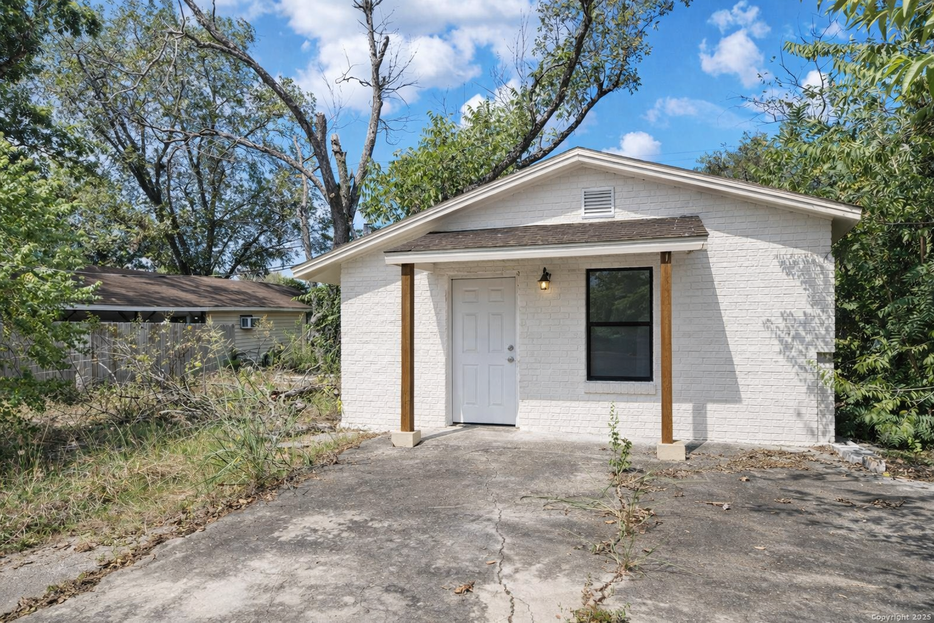
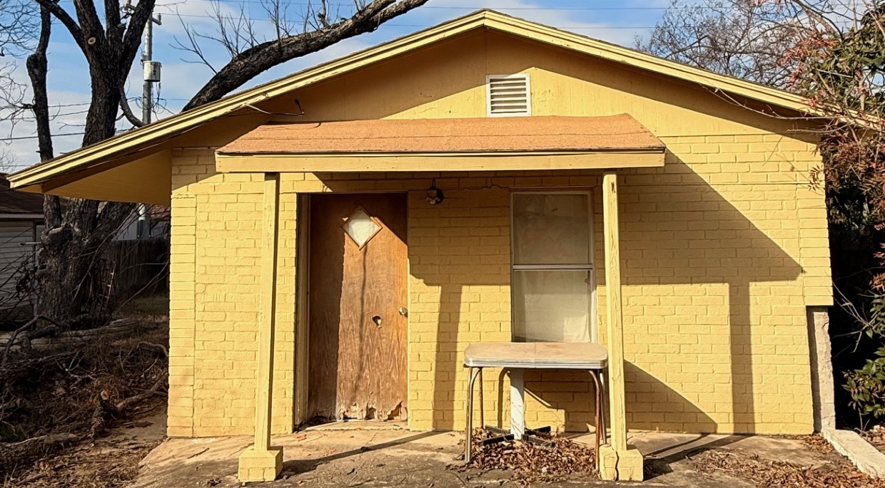
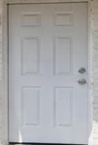
Remodel Request – Exterior Changes
As-IS
to-be
Windows
ADU Front Door
Lighting
  * Note: This image is a rendering please keep in mind that colors may vary based on lighting.

Slide 20
Contact us:
Email:
Sea2seallc.tx@gmail.com
Cell:
210-840-3360
Owner:
Jose Mora

